Slide 1
A Heuristic Algorithm for the
N-LCS Problem
Mourad Elloumi and Ahmed Mokaddem
Journal of the Applied Mathematics, Statistics and Informatics (JAMSI), 4 (2008), No. 1
Presenter : Hsiang-Yi Weng
Date : Dec. 9, 2008

Slide 2
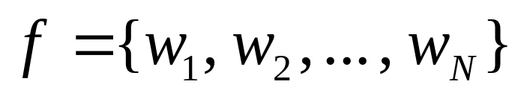
Abstract (1/3)
Let be a set of N strings,
a string s is an N-Common Subsequence (N-CS)
of f, if and only if, s is a subsequence of each
of the N strings of f. Hence, the N-Longest
Common Subsequence (N-LCS) problem
is defined as follows: Given a set of N strings
find an N-CS of f of
maximum length.

Slide 3
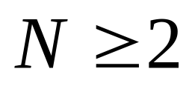
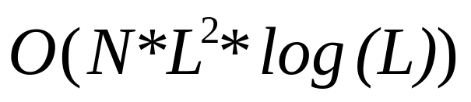
Abstract (2/3)
When N > 2, the N-LCS problem becomes
NP-hard and even hard to be approximated.
In this paper, we present a heuristic algorithm,
adopting a regions approach, for the N-LCS
problem, where . Our algorithm is
in computing time, where L
is the maximum length of a string.

Slide 4
Abstract (3/3)
During each recursive call to our algorithm :
We look for the longest common substrings
that appear in the different strings. If we have
more than one longest common substring, we
do a filtering.

Slide 5
N-Longest Common Subsequence
w₁=AGCTAATCA
w₂=GTACGATCT
w₃=TATCCATCG
LCS=ACATC

Slide 6
A Heuristic algorithm for the N-LCS problem(1/8)
Let f be a set of strings, a Common Subsequence (CS) to the strings of f is a list of substrings that appear in the same order, and without overlappings, in all the strings of f.
w₁=AGCTAATCA
w₂=GTACGATCT
w₃=TATCCATCG
LCS=TAATC

Slide 7










A Heuristic algorithm for the N-LCS problem(2/8)
A list made up by the positions of the first characters of x, in the strings w₁, w₂, …, w_{N}, is called alignment of x.

Slide 8
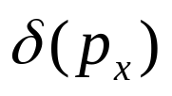
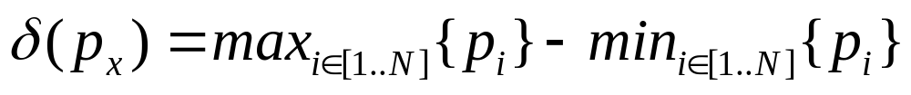

A Heuristic algorithm for the N-LCS problem(3/8)
The width of an alignment p_{x}, denoted by , is defined by :

Slide 9
A Heuristic algorithm for the N-LCS problem(4/8)
w₁=AGCTAATCA
w₂=GTACGATCT
w₃=TATCCATCG

Slide 10
A Heuristic algorithm for the N-LCS problem(5/8)
w₁=AGCTAATCA
w₂=GTACGATCT
w₃=TATCCATCG

Slide 11
A Heuristic algorithm for the N-LCS problem(6/8)
w₁=AGCTAATCA
w₂=GTACGATCT
w₃=TATCCATCG
w_{1l}=AGCTA
w_{2l}=GTACG
w_{3l}=TATCC
w_{1r}=A
w_{2r}=T
w_{3r}=G

Slide 12
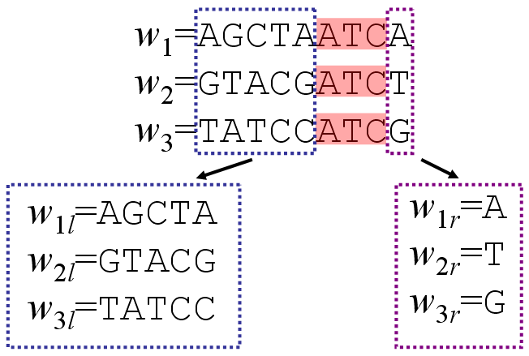
A Heuristic algorithm for the N-LCS problem(7/8)
w_{1lm}=AGC
w_{2lm}=G
w_{3lm}=
w_{1ln}=
w_{2ln}=CG
w_{3ln}=TCC

Slide 13
A Heuristic algorithm for the N-LCS problem(8/8)
w_{1lm}=AGC
w_{2lm}=G
w_{3lm}=
w_{1ln}=
w_{2ln}=CG
w_{3ln}=TCC
LCS=TAATC

Slide 14

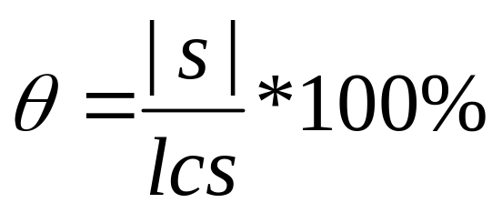
Measures of the Algorithm Performances
Let s and lcs be, respectively, an N-CS and an N-LCS to f. Let us call the rate defined by :

Slide 15
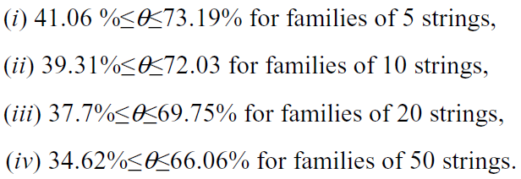
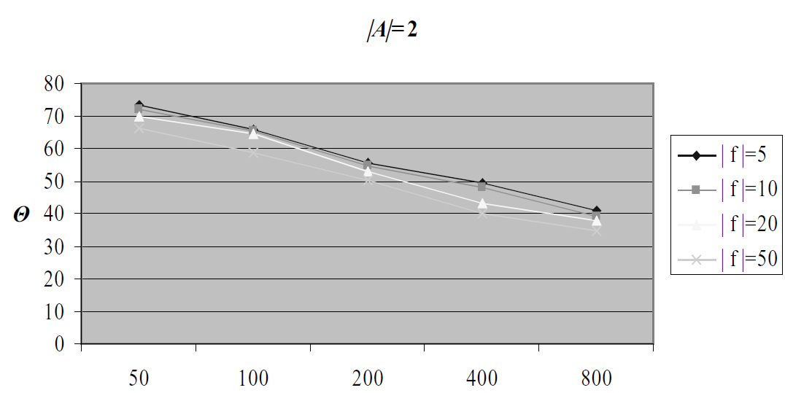
Result

Slide 16
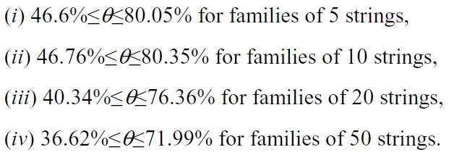
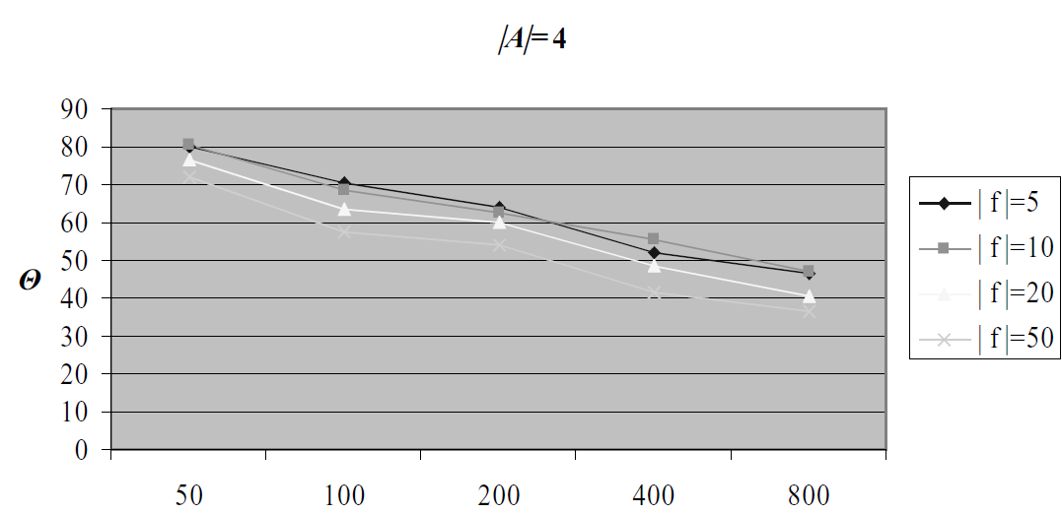
Result

Slide 17
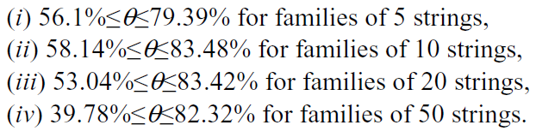
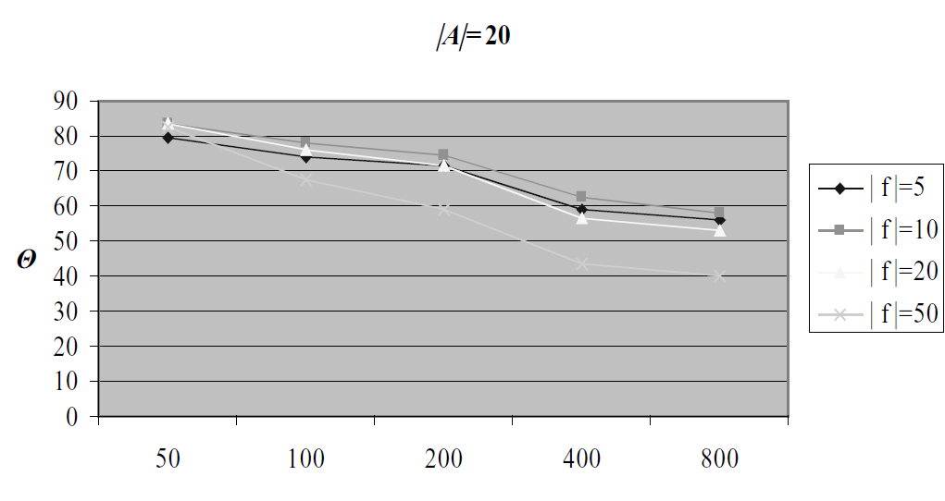
Result

Slide 18
Conclusion
Our algorithm is in computing time, where N is the number of the strings and L is the maximum length of a string.
We are now working on improving more the performances of this algorithm.
A variant of our algorithm has been developed to deal with the Multiple Sequence Alignment (MSA) problem.

